Slide 1
All about Feature Transformation
Abu Bakar Siddique Mahi

Slide 2

All about Feature Transformation
What is Feature Transformation?

Slide 3



All about Feature Transformation

Slide 4
All about Feature Transformation
Features: Length = 100m
Magnitude (100)
Units (m)

Slide 5
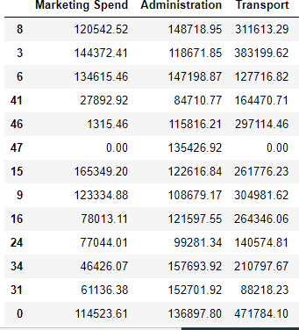
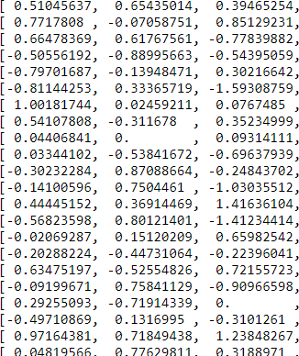
All about Feature Transformation
Before
After

Slide 6
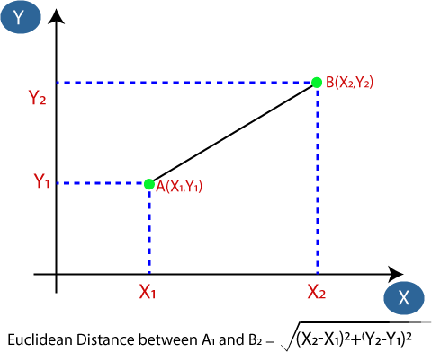
Calculating Distance for ML Algorithm
The Euclidean Distance between two points is calculated using a simple formula.

Slide 7
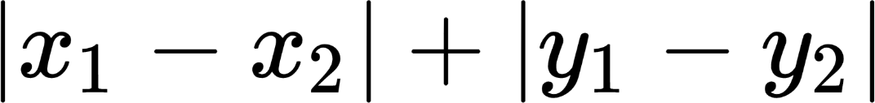
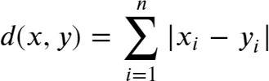
Calculating Distance for ML Algorithm
The Manhattan Distance between two points is calculated using a simple formula.
Manhattan Distance =
Manhattan Distance =

Slide 8
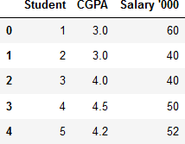

Calculating Distance for ML Algorithm

Slide 9
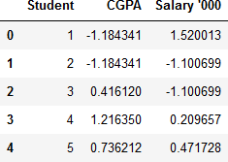

Calculating Distance for ML Algorithm

Slide 10
All about Feature Transformation
Techniques
Few advantages of feature scaling the data are as follows:
It makes your training faster.
It prevents you from getting stuck in local optima.
It gives you a better error surface shape.
However, there are few algorithms such as Tree based algorithms and probability based algo. that are not affected by scaling of input data.

Slide 11
All about Feature Transformation
Techniques
Examples of Algorithms where Feature Scaling matters:
K-Means uses the Euclidean distance measure here feature scaling matters.
K-Nearest - Neighbours also require feature scaling.
Principal Component Analysis (PCA): Tries to get the feature with maximum variance, here too
feature scaling is required.
Gradient Descent: Calculation speed increase as Theta calculation becomes faster after feature scaling.
Note: Naive Bayes, Decision Tree, Random Forest & All tree-based models are not affected by feature
scaling.

Slide 12
Feature Transformation
Techniques to perform Feature Transformation:
Normalization
Standardization
Robust Scaler
Max Absolute Scaler

Slide 13
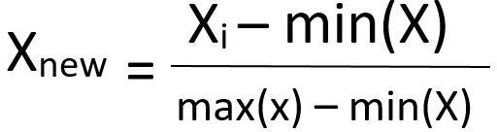
Feature Transformation
Normalization:
Python Implementation:
from sklearn.preprocessing import MinMaxScaler scaler = MinMaxScaler()

Slide 14
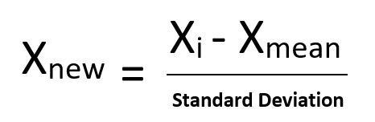
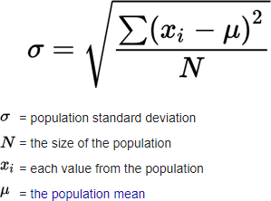
Feature Transformation
Standardization:
Standard Deviation:
Python Implementation:
from sklearn.preprocessing import StandardScaler scaler = StandardScaler()

Slide 15
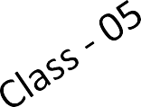

Feature Transformation
In simplest terms, the Max Absolute Scaler takes the absolute maximum value of each column and divides each value in the column by the maximum value.
Formula:
Python Implementation:
from sklearn.preprocessing import MaxAbsScaler scaler = MaxAbsScaler()

Slide 16
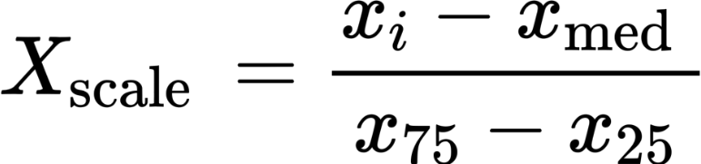
Feature Transformation
Robust Scaler are robust to outliers. It is used to scale the feature to median and quantiles Scaling using median and quantiles consists of subtracting the median to all the observations, and then dividing by the interquartile difference. The interquartile difference is the difference between the 75th and 25th quantile:
IQR = 75th quantile - 25th quantile
RobustScaler= (Xi – X.Median)/IQR
Formula:
Python Implementation:
from sklearn.preprocessing import RobustScaler RoSc=RobustScaler()

Slide 17
Let’s do it with PYTHON

